Slide 1
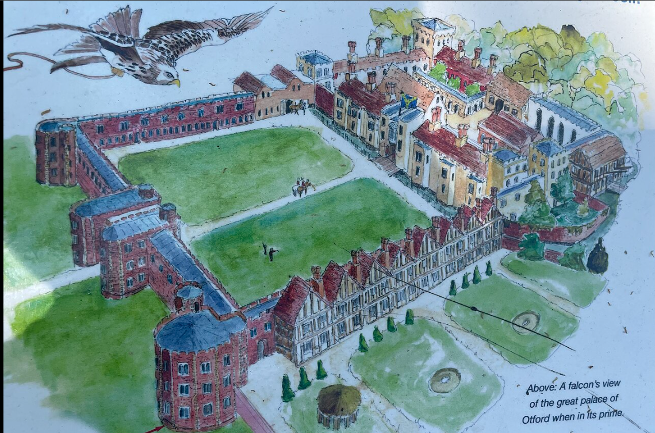
What can Otford Palace in Kent tell us about the power of the Medieval Church?
Story
Source
‘…that the English Church shall be free and shall have its rights undiminished and its liberties unimpaired’
 | Summarise each paragraph in one or two points.
In c.791 CE, Offa, the King of Mercia, gave lands at Otford to Christ Church Canterbury. This was a very significant gift. It meant that the Monastery of Christ Church Canterbury and subsequently the Archbishops of Canterbury became the Lords of the Manor of Otford. After the Norman Conquest in 1066, the first Norman Archbishop of Canterbury, Lancfranc, took the position in 1070. Lanfranc was a good friend of William the Conqueror, and he built a manor house at Otford (probably of wood) for his use when he was staying in the Village. By the Domesday Survey in 1086, the land at Otford owned six watermills and a large farm locally, worked by tenants who were bound to the land. Thomas Becket, Archbishop of Canterbury (1162–1170 during the reign of Henry II) it is said, particularly liked staying at Otford, which he did several times. During the Black Death plague outbreak, Edward III brought his whole court to Otford to spend Christmas away from London, and the manor at Otford was later attacked during the 1381 Peasants’ Revolt. William Warham, Archbishop of Canterbury during the reign of Henry VII and later Henry VIII, built Otford Palace in 1514, which rivalled Hampton Court Palace in size. Henry VIII visited Otford Palace with his court in 1519, from where he went hunting. A year later he returned with his wife Catherine of Aragon with the royal court to stay at the palace en route to France where he was to meet Francis, King of France at the Field of Gold. The court that accompanied Henry was believed to have been over 3,000 people. After the Reformation, Henry VIII became its owner and spent lavishly on it. However, in time, he decided that he preferred Knole House a few miles away in Sevenoaks, because it was less damp. After Henry’s death in 1547, the Palace was owned successively by his children, before it fell gradually into disrepair.
One of the first clauses of the Magna Carta (1216). The Archbishop of Canterbury, Stephen Langton, was one of those who presented the Magna Carta to King John
B
‘…one of the grandest houses in England’
The Court Roll describing The Archbishop’s residence at Otford in 1534
A modern drawing recreating Warham’s 16th Century Palace at Otford
C
A
Scholarship
…Edward I was extremely angry with Archbishop Winchelsey in 1296 for obeying the papal bull (order from the Pope)…which forbade the clergy to pay taxes to the secular authorities
Dennis Clarke and Anthony Stoyd, Historians, 1975
His house was to be more than just a place of showy habitation, work and leisure…at Otford, Warham (Archbishop of Canterbury) could consolidate and present a carefully conceived public image. It was his seat of power, a vast image of lordly authority, and it was the place at which he could show off his wealth, his hospitality and largesse, and his intellect to royal and ambassadorial guests alike.
Alden Gregory, Historian and Curator
Task 1 Read through the Story of Otford Palace. For each paragraph, you need to create a short summary (two bullet points maximum) on the right-hand side | Task 2 Look at sources A, B, and C. In your book answer the question “What do these sources tell you about Otford Palace and the power of the Church before the English reformation in 1533? | Task 3 Read through the scholarship about Otford Palace. Highlight what you think are the two most important points. In your book, answer the question “What does Otford Palace suggest about how powerful the Church was before the English reformation?”

