Slide 1
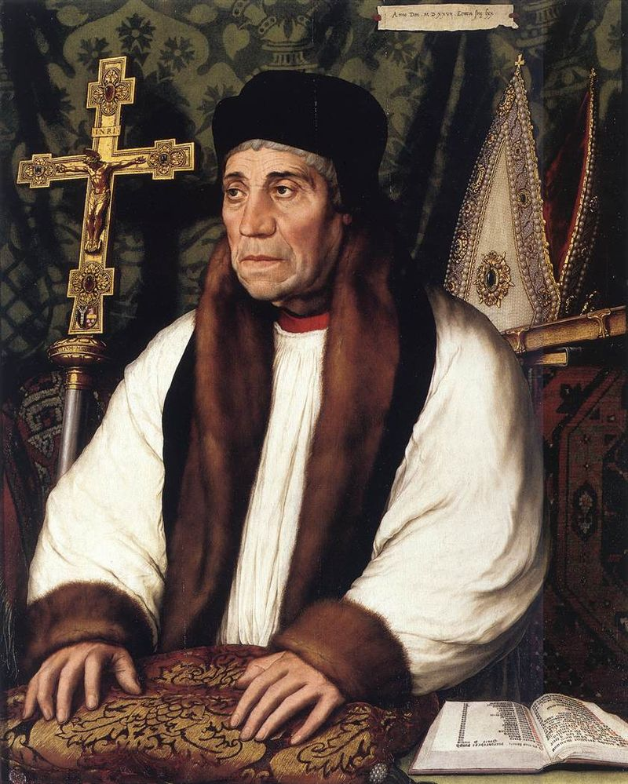
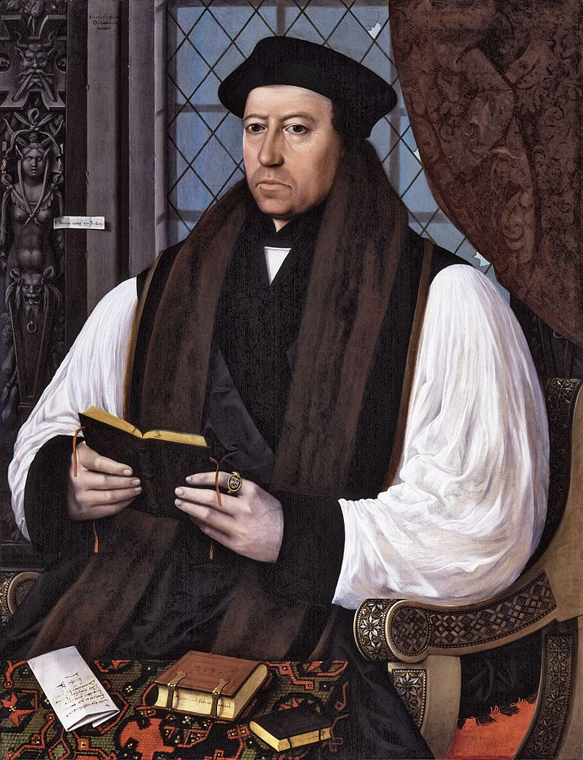
What can Otford Palace in Kent tell us about the English Reformation?
Story
Source
Create a title for each paragraph. | Summarise each paragraph in one or two bullet points.
In c.791 CE, Offa, the King of Mercia, gave lands at Otford to Christ Church Canterbury. This was a very significant gift. It meant that the Monastery of Christ Church Canterbury and subsequently the Archbishops of Canterbury became the Lords of the Manor of Otford. After the Norman Conquest in 1066, the first Norman Archbishop of Canterbury, Lancfranc, took the position in 1070. Lanfranc was a good friend of William the Conqueror, and he built a manor house at Otford (probably of wood) for his use when he was staying in the Village. By the Domesday Survey in 1086, the land at Otford owned six watermills and a large farm locally, worked by tenants who were bound to the land. . Thomas Becket, Archbishop of Canterbury (1162–1170 during the reign of Henry II) it is said, particularly liked staying at Otford, which he did several times. During the Black Death plague outbreak, Edward III brought his whole court to Otford to spend Christmas away from London, and the manor at Otford was later attacked during the 1381 Peasants’ Revolt. William Warham, Archbishop of Canterbury during the reign of Henry VII and later Henry VIII, built Otford Palace in 1514, which rivalled Hampton Court Palace in size. Henry VIII visited Otford Palace with his court in 1519, from where he went hunting. A year later he returned with his wife Catherine of Aragon with the royal court to stay at the palace en route to France where he was to meet Francis, King of France at the Field of Gold. The court that accompanied Henry was believed to have been over 3,000 people. After the Reformation, Henry VIII became its owner and spent lavishly on it. However, in time, he decided that he preferred Knole House a few miles away in Sevenoaks, because it was less damp. After Henry’s death in 1547, the Palace was owned successively by his children, before it fell gradually into disrepair.
A
B
Archbishop Warham, 1528
Archbishop Cranmer, 1545
In his book A perambulation of Kent, written in 1570, Lambarde wrote: “whereof the olde hall and chapelle onely doe one remaine.” By the 17th Century it was largely a ruin.
C
Scholarship
Charles Shee,
Historian and archaeologist
In the early 16th century Archbishop Warham built his enormous palace in Otford. His successor Thomas Cranmer enjoyed walking and hunting in the parks. Unfortunately for him, at the time of the Reformation he was compelled in 1537 to surrender Otford manor and lands to Henry VIII. In 1539 Henry VIII imported deer into his Otford parks and in 1541 he spent money on maintenance of parks at Otford and Knole. Henry died in 1547, having never spent much time at Otford (when in the vicinity he preferred to stay at Knole).
Moreover Warham also identified closely with the saint. Not only was he himself increasingly sidelined by his peers, but like [Thomas] Becket he was an archbishop overseeing a church losing its powers and subjugated by the secular (non-religious) authorities. Warham had risen to power under Henry VII, who he had served loyally, but when Henry VIII succeeded him the Archbishop found himself frequently at odds with the King.
Alden Gregory, Historian and Curator
Task 1 Read through the Story of Otford Palace. For each paragraph, you need to create a short summary (two bullet points maximum) on the right-hand side | Task 2 Look at the backgrounds of sources A and B – what do they tell us about the position of the Archbishop of Canterbury before and after the Reformation? What does Source C tell us about Otford Palace after the Reformation? | Task 3 Read through the scholarship about Otford Palace. Highlight what you think are the three most important sentences. In your book, answer the question “What can Otford Palace tell us about the power of the King versus the power of the Church before and after the Reformation?”

